Slide 1
SRI SIVASUBRAMANIYA NADAR COLLEGE OF ENGINEERING
SSN RESEARCH INTERNSHIP 2022
Automated Irrigation System with Crop Recommendation System
Project ID: IT13
Mentor
Dr. I. Joe Louis Paul M.E., Ph.D.,
Associate Professor
Department of Information Technology
SSN College of Engineering
Presented by
Roheth S,
II Year
Department of Information Technology
Sri Venkateswara College of Engineering

Slide 2
Contents
Hypothesis
Objective
Block Diagram
Flow Chart
Implementation
Dataset
Algorithm
Analysis/Result
Advantages
Limitations
Conclusion and Future Scope
References

Slide 3
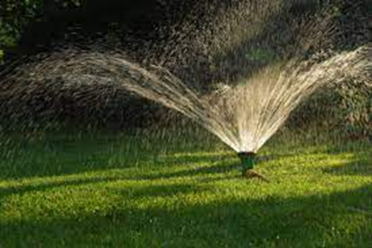
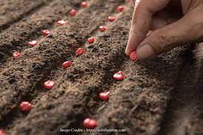
Hypothesis
Conserves water and save time.
Suitable Crop is recommended.

Slide 4

Objectives
To build a prototype for automatic irrigation.
To provide the crop recommendation system to the farmers.

Slide 5
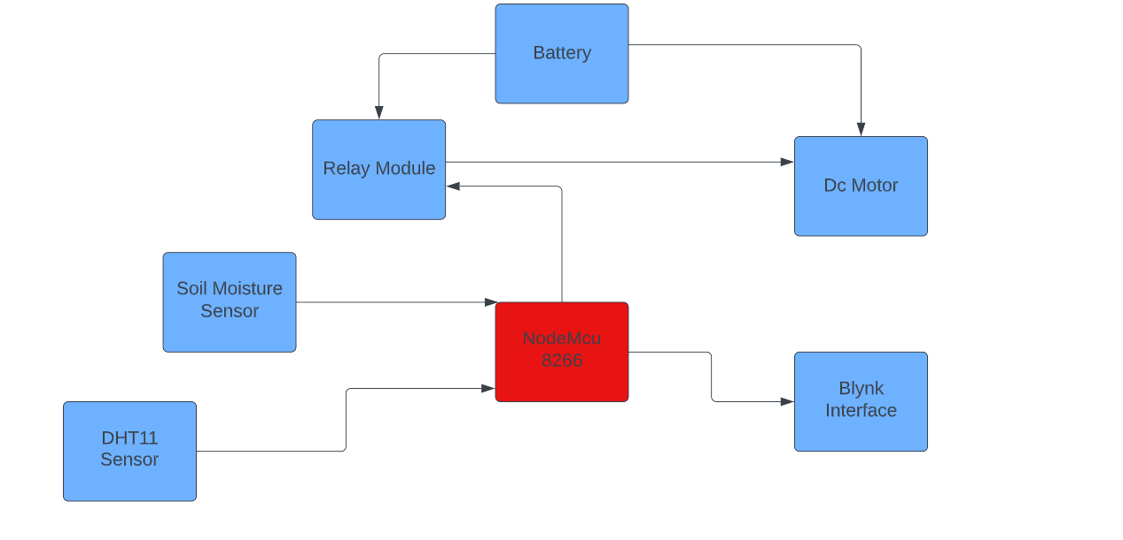
Block Diagram

Slide 6
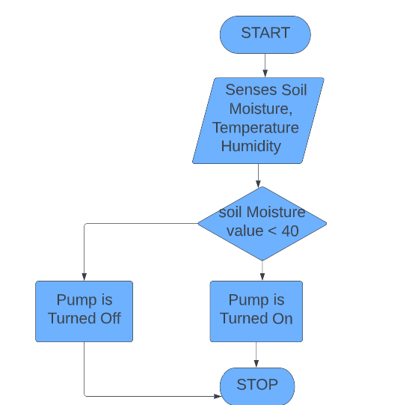
Flow Chart

Slide 7
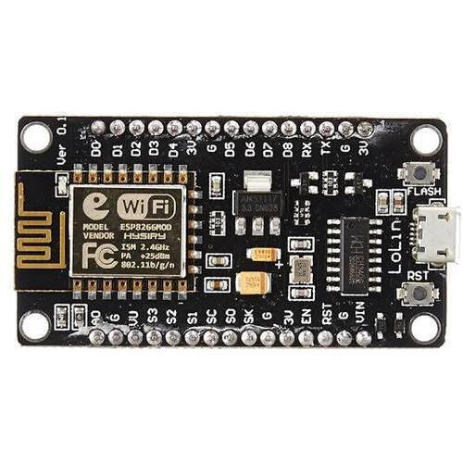
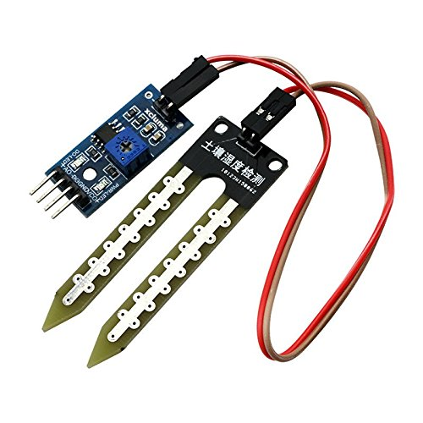
Implementation (1/7)
Components Used
Name | Image | Purpose
1. NodeMCU ESP8266 |  | NodeMCU is an open source platform based on ESP8266 which can connect objects and let data transfer using the Wi-Fi protocol.
2. Soil Moisture Sensor |  | Soil moisture sensors measure or estimate the amount of water in the soil.

Slide 8
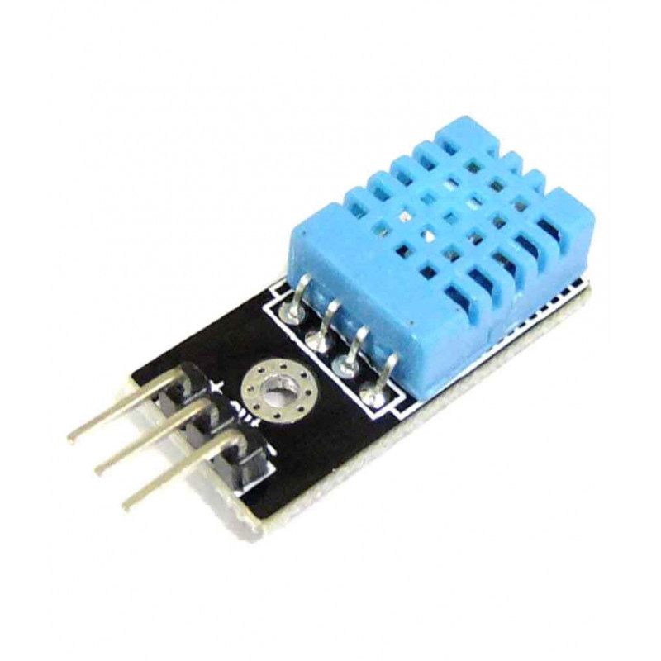
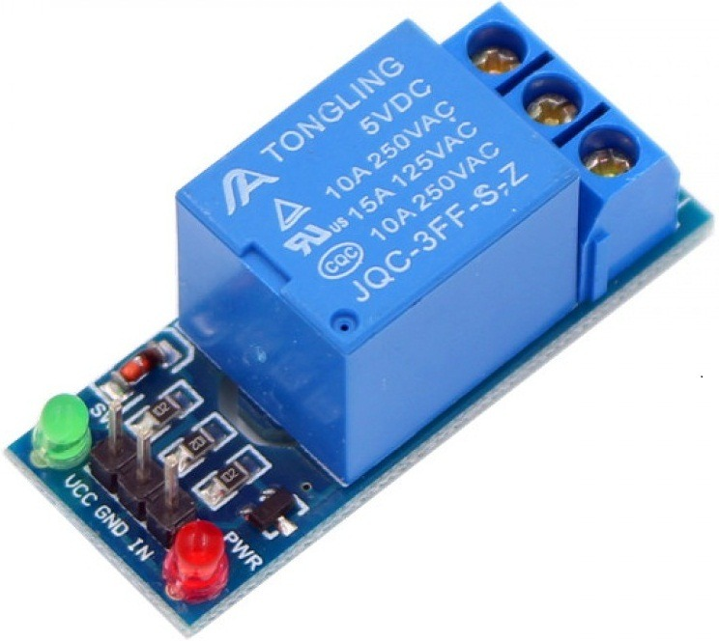
Implementation (2/7)
Name | Image | Purpose
3. DHT11 Sensor |  | DHT11 sensors is used to measure Temperature and Humidity value.
4. Relay Module |  | A power relay module is an electrical switch that is operated by an electromagnet.

Slide 9
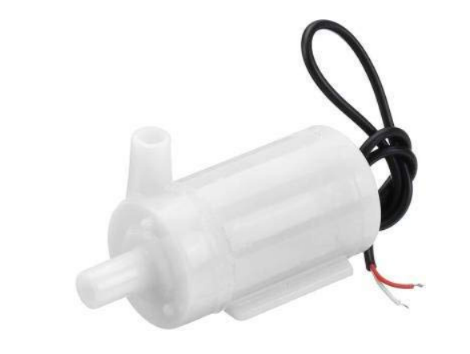
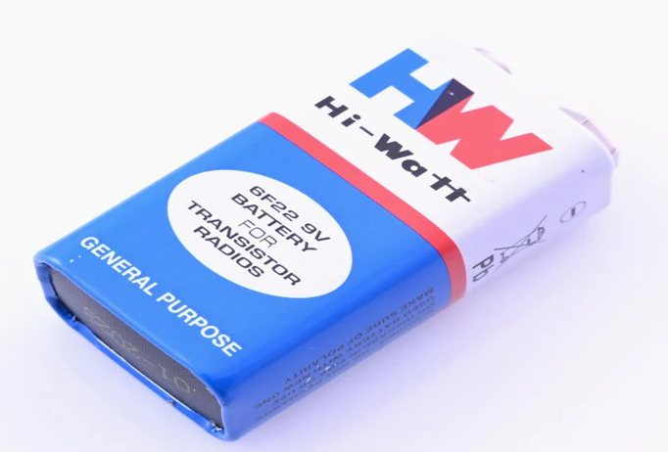
Implementation (3/7)
Name | Image | Purpose
5. Dc Motor |  | DC powered pumps use direct current from motor to move fluid in a variety of ways.
6. Battery |  | Battery is used to give power supply to motor.

Slide 10
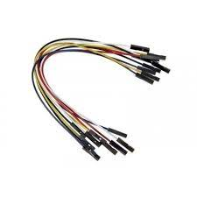
Implementation (4/7)
Name | Image | Purpose
7. Jumper Wires |  | Jumper wires are electrical wires with connector pins at each end. They are used to connect two points in a circuit without soldering.

Slide 11
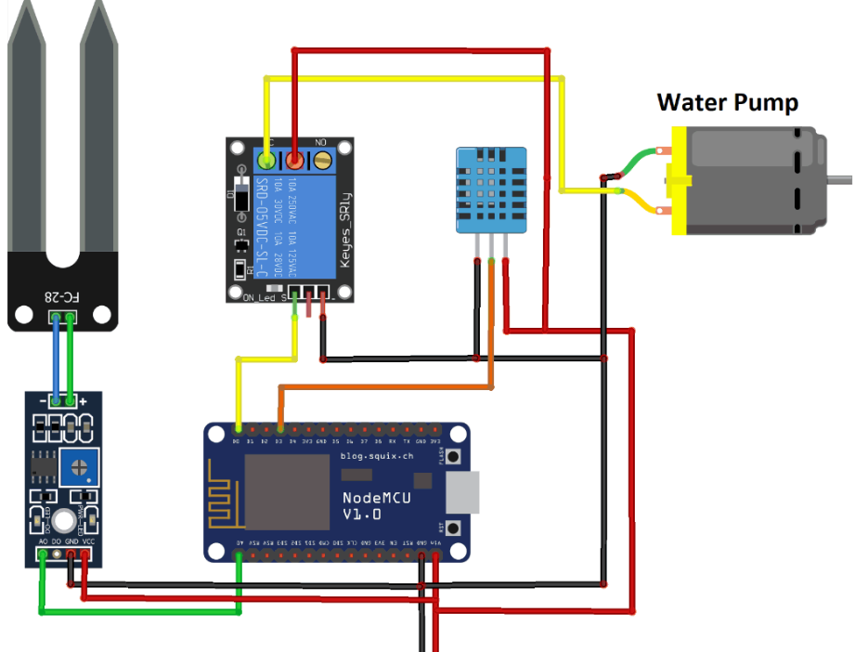
Implementation (5/7)
Circuit Diagram

Slide 12
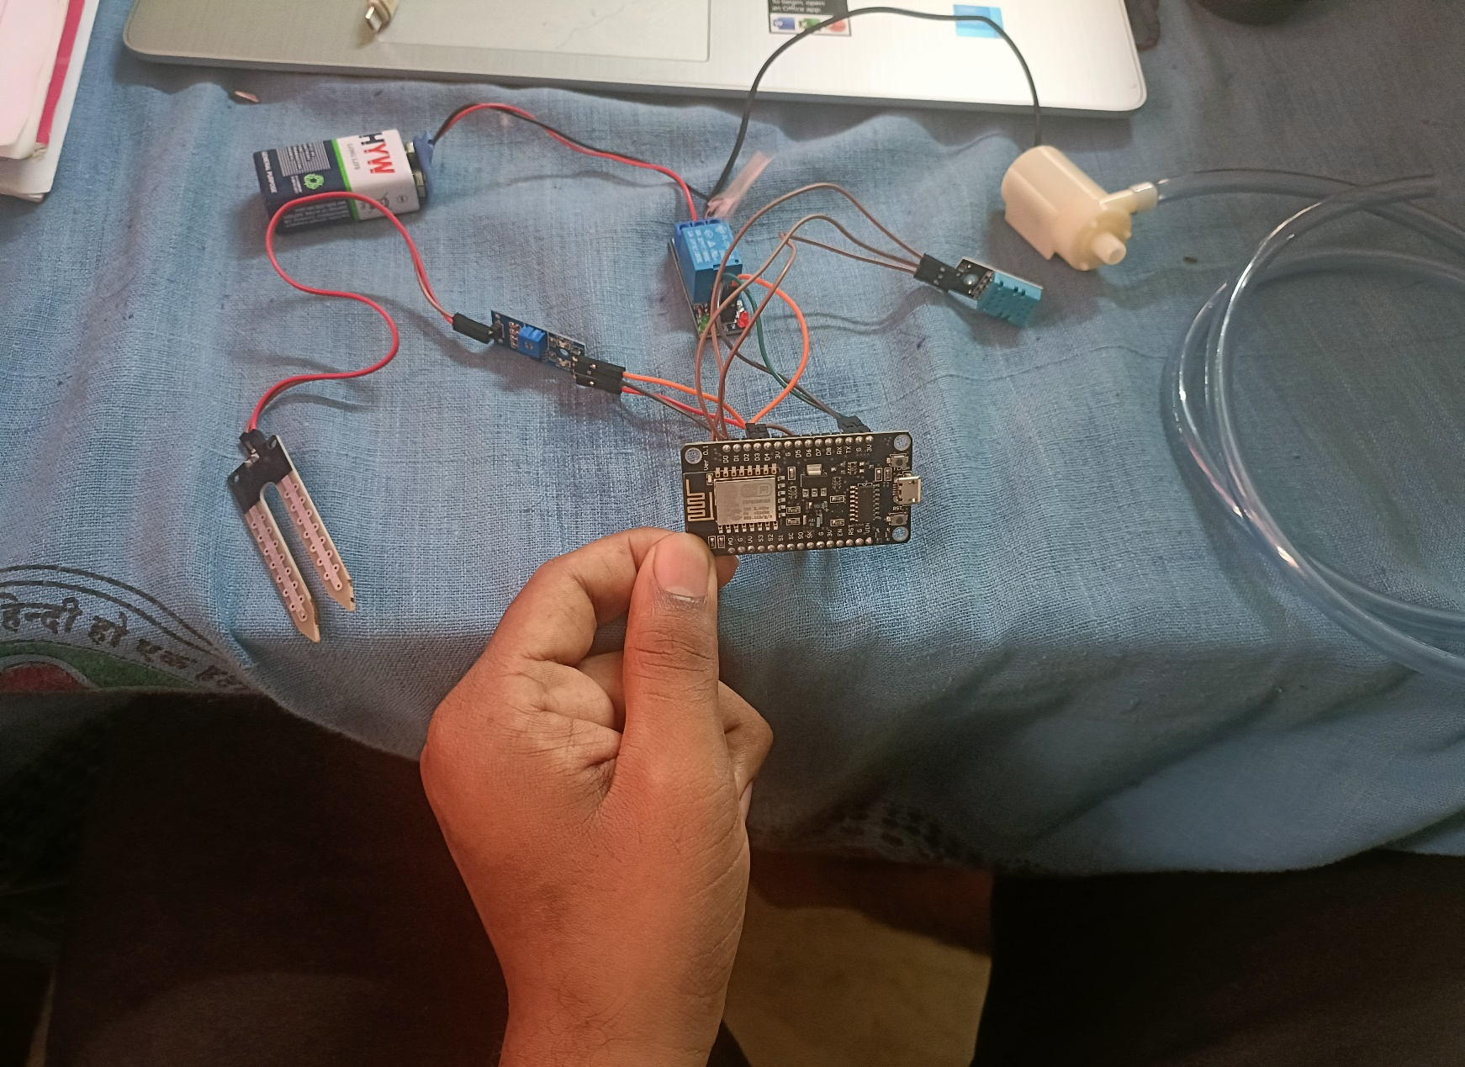
Implementation (6/7)

Slide 13
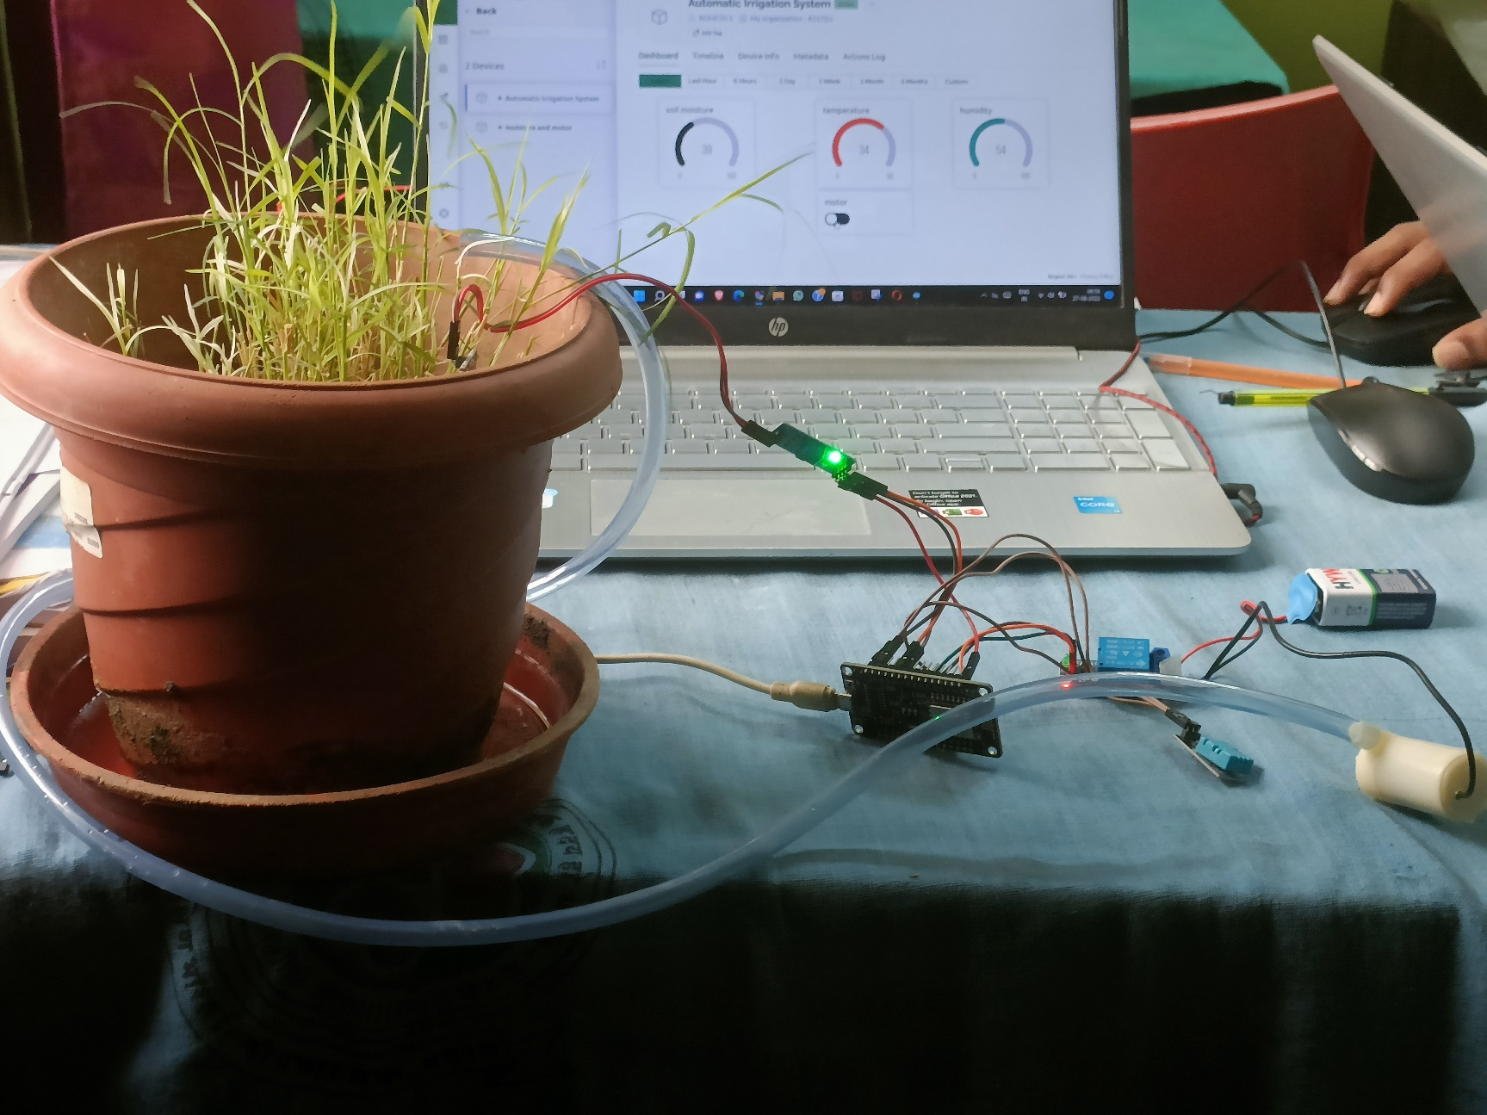
Implementation (7/7)
Setup

Slide 14
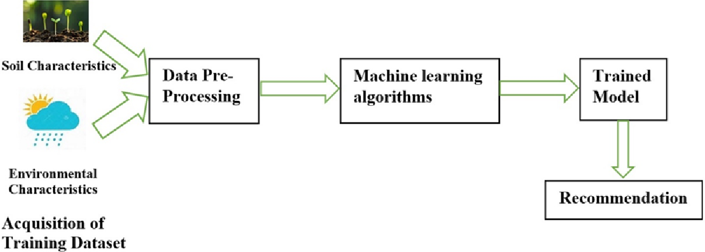
Dataset
Source: GitHub
Sample Size: 2200
Independent Variables: Nitrogen(N), Phosphorous(p) Potassium(k), Temperature, Humidity, pH, Rainfall
Dependent Variable: Crop

Slide 15
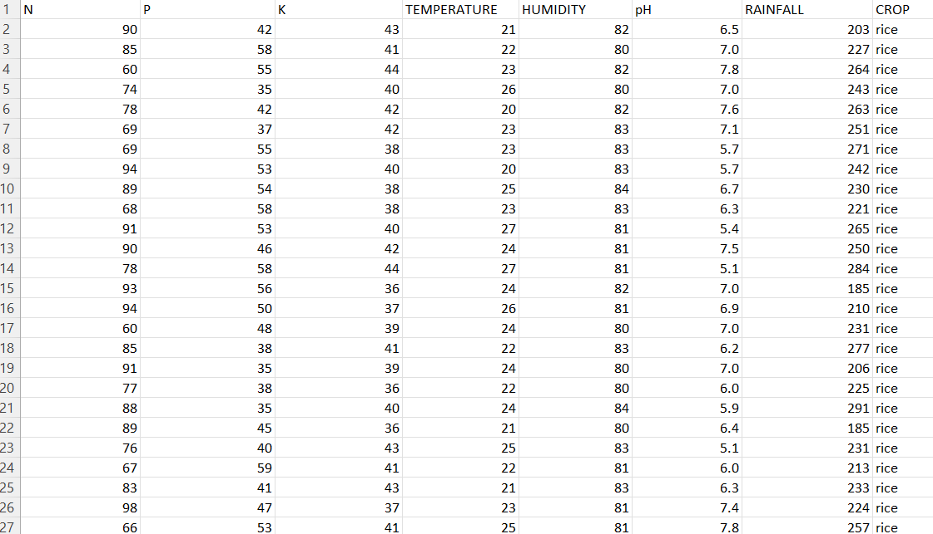
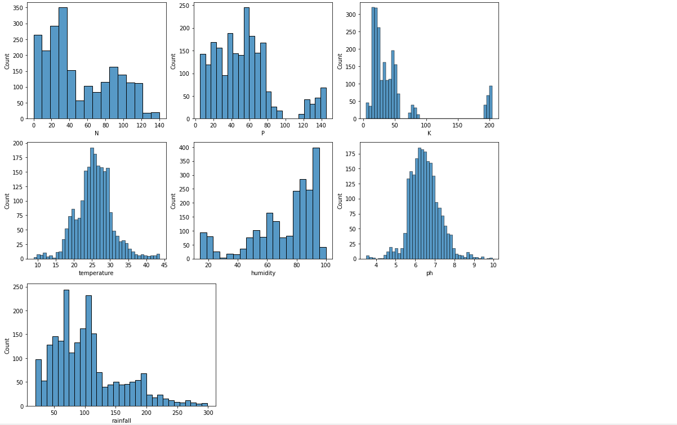
Algorithm
Algorithm used: KNN
Accuracy: 98%

Slide 16
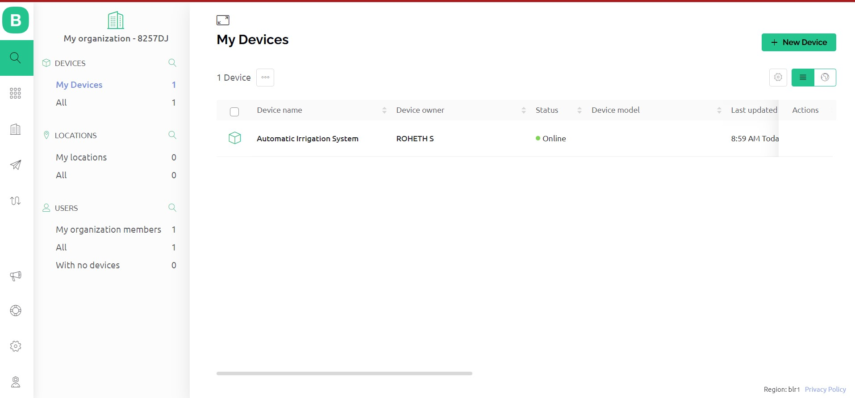
Analysis/Result (1/8)
Blynk Interface

Slide 17
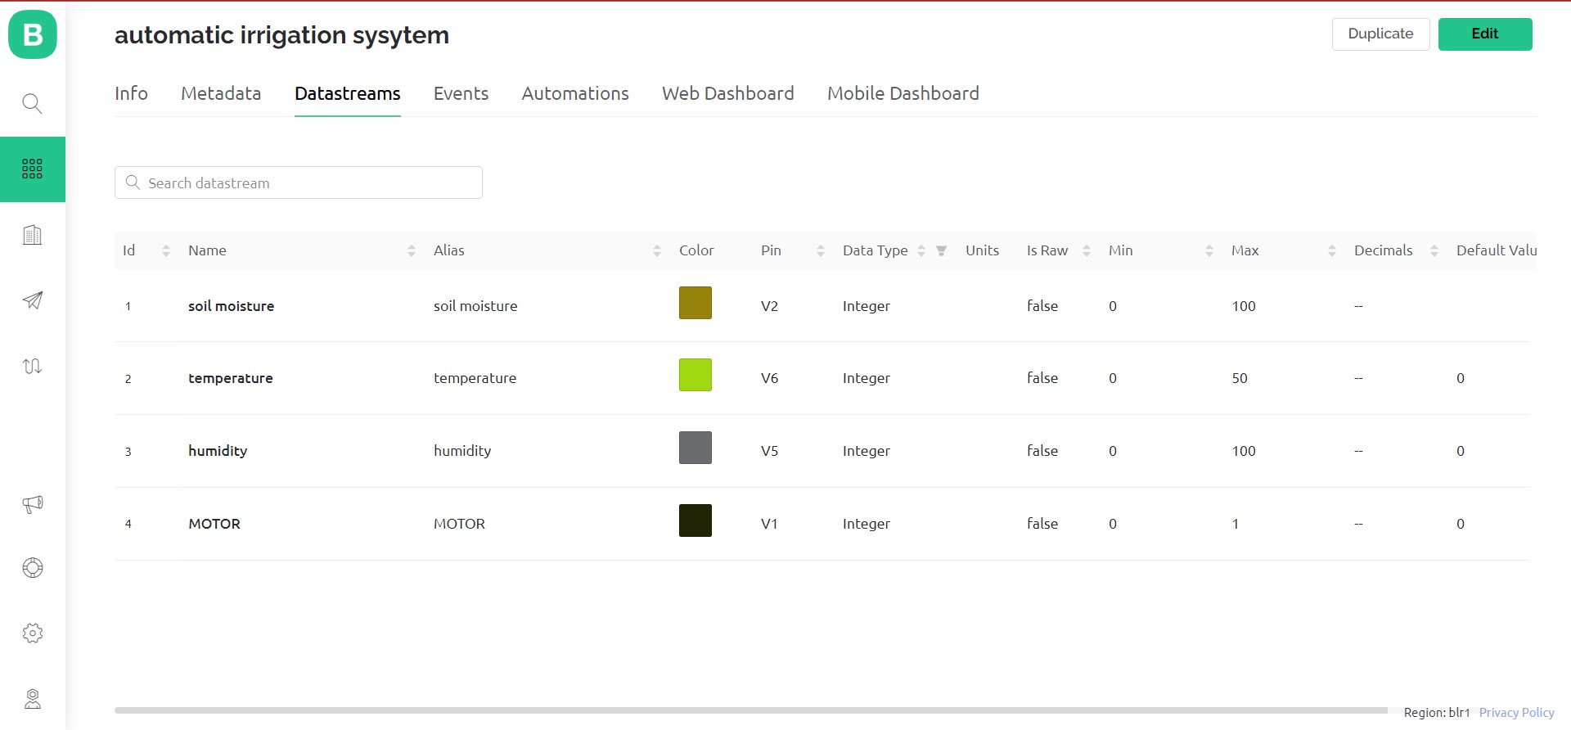
Analysis/Result (2/8)
.

Slide 18
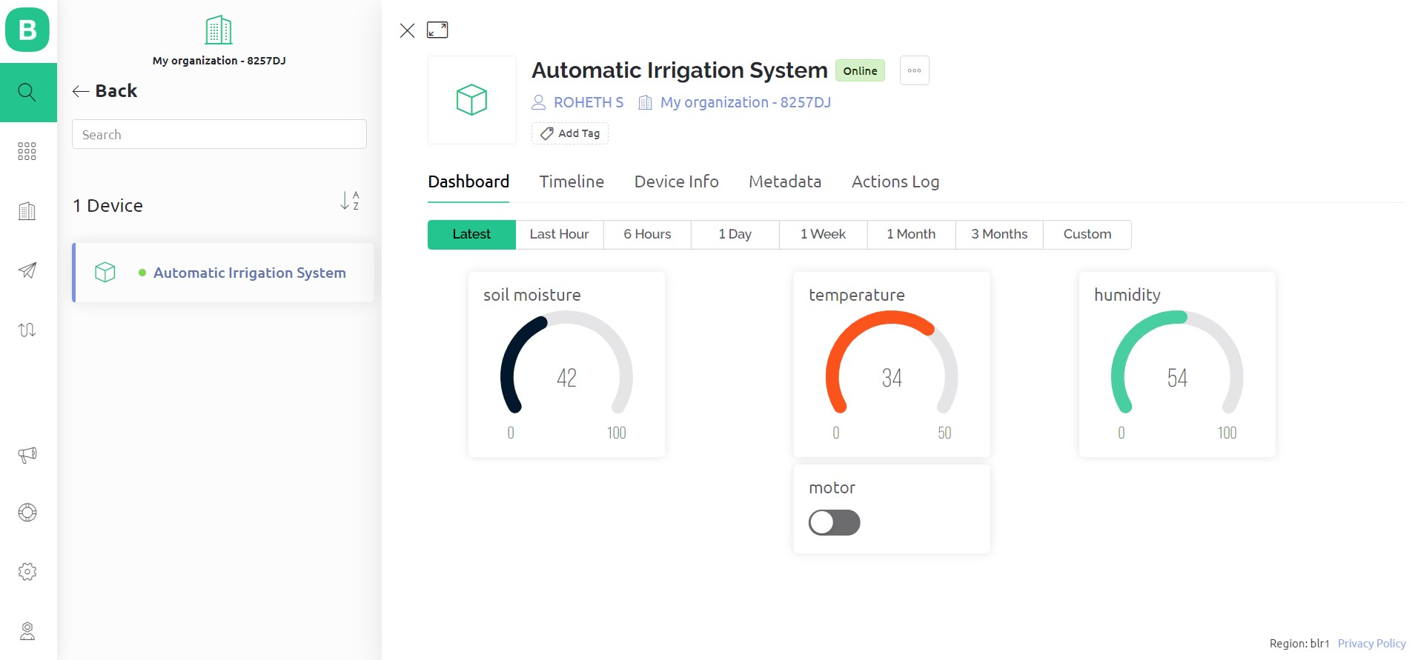
Analysis/Result (3/8)
Web Dashboard

Slide 19
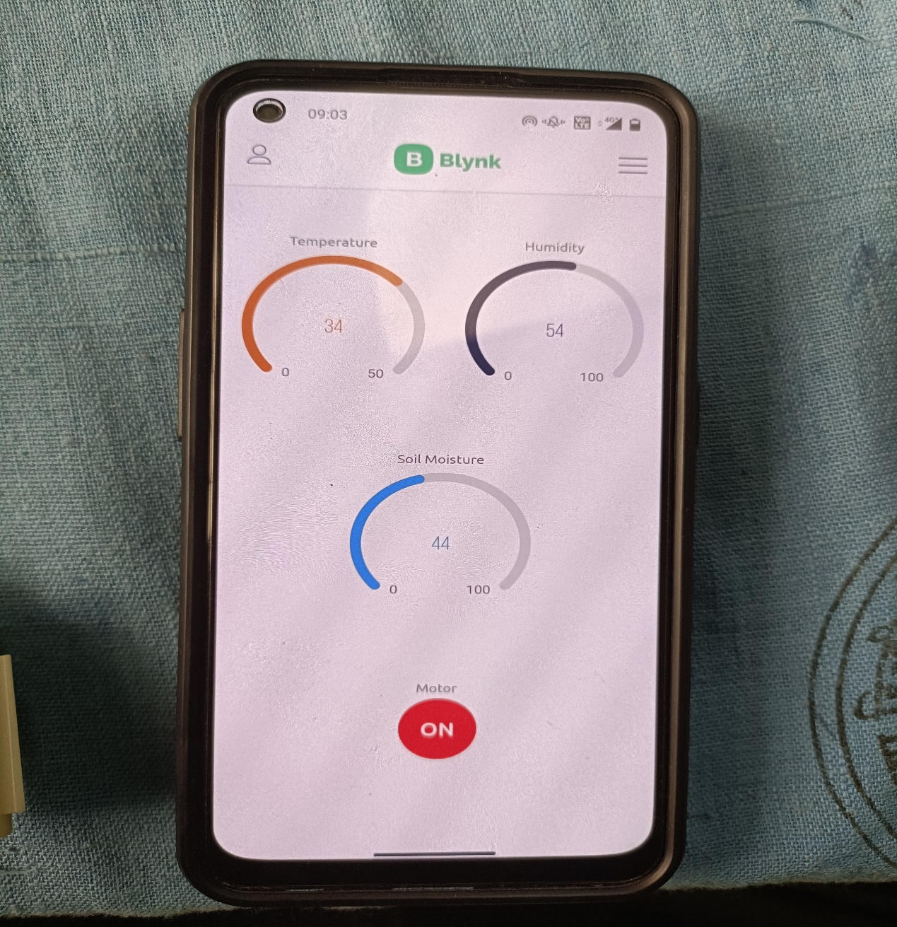
Analysis/Result (4/8)
Mobile Dashboard

Slide 20
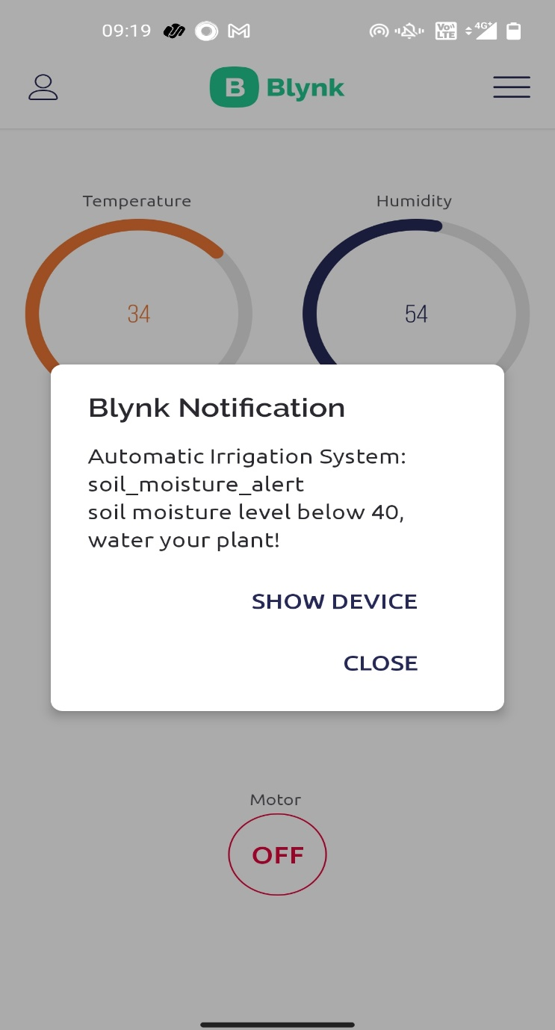
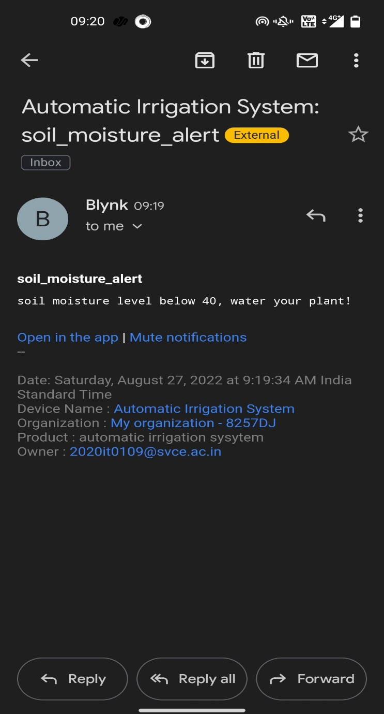
Analysis/Result (5/8)

Slide 21
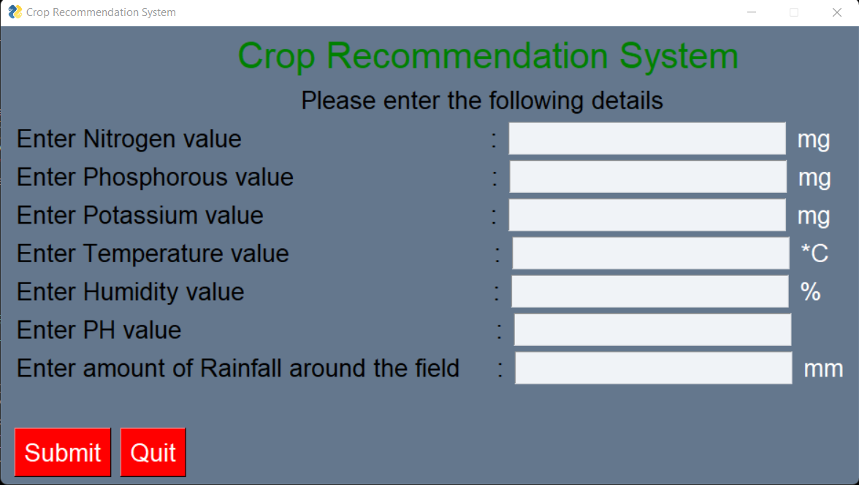
Analysis/Result (6/8)
Crop Recommendation System GUI

Slide 22
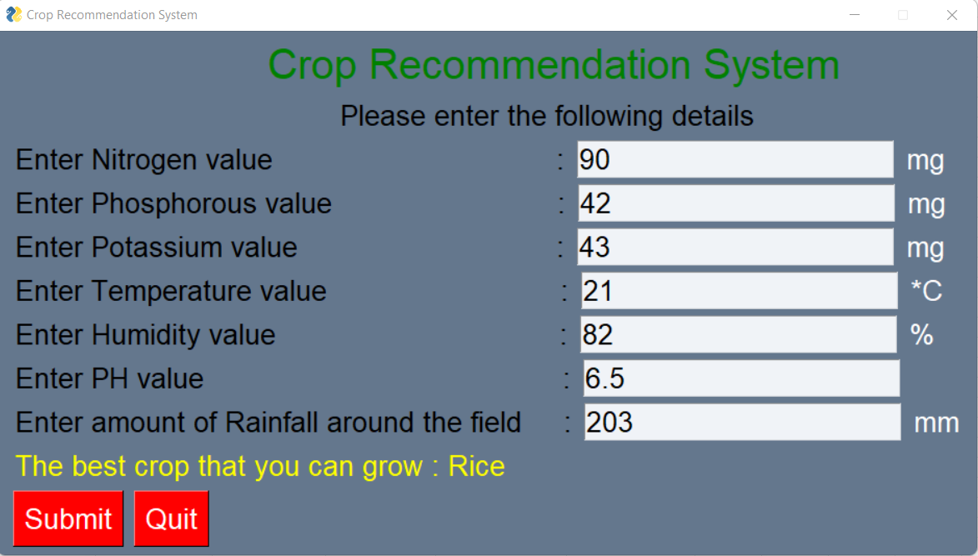
Analysis/Result (7/8)

Slide 23

Analysis/Result (8/8)

Slide 24

Advantages
Saves labor costs and promotes timely irrigation (watering plants only when necessary).
Assists the farmers in choosing the best crop to sow in their field and boosts productivity.

Slide 25

Limitations
The prototype needed a power source and Wi-Fi.
Machine learning algorithms need to train on a large scale, as well as on region-specific data.
The available data determines the accuracy of the model forecast.

Slide 26

Conclusion
Thus, the purpose of “Automatic Irrigation System” is rightly served by providing ease to farmers. It will also be very helpful in saving wastage of water as it uses automatic irrigation method.
Thus the purpose of “crop recommendation system” would help farmers in sowing the right seed based on soil requirements to increase productivity and acquire profit out of such a technique.

Slide 27

Future scope
NPK sensor, pH sensor and Rainfall Sensor can be implemented. By this, we can train the model with real time data.
LoRa WLAN technology can be implemented for long-range, low-power communications.

Slide 28
References
Kumar, J., Gupta, N., Kumari, A., & Kumari,”Automatic Plant Watering and Monitoring System using NodeMCU”, 2019.
S.Pudumalar, E.Ramanujam, R.Harine Rajashreeń, C.Kavyań, T.Kiruthikań, J.Nishań,” Crop Recommendation System for Precision Agriculture”, 2020.
R. Priya and D. Ramesh, “ML based sustainable precision agriculture: a future generation perspective,” Sustainable Computing: Informatics and Systems, vol. 28, no. 100439, Article ID 100439, 2020.
Y. Mekonnen, S. Namuduri, L. Burton, A. Sarwat, and S. Bhansali, “Review-machine learning techniques in wireless sensor network based precision agriculture,” Journal of the Electrochemical Society, vol. 167, no. 3, Article ID 037522, 2019.
M. Bacco, A. Berton, E. Ferro, C. Gennaro, A. Gotta, S. Matteoli, F. Paonessa, M. Ruggeri, G. Virone, A. Zanella, Smart farming: Opportunities, challenges and technology enablers, 2018 IoT Vert. Top. Summit Agric. - Tuscany, IOT Tuscany, 2018.
M. Van Rooyen, N. Luwes, E. Theron, Automated soil classification and identification using machine vision, 2017 Pattern Recognit. Assoc. South Africa Robot. Mechatronics Int. Conf. PRASA-RobMech, 2018.

Slide 29


